Slide 1
Publishing your Community Engaged Scholarship
Ross Brooke Watts, Ph.D.
Director, Dornsife Center for Community Engagement
23 May 2018

Slide 2
Today’s Objectives
To review definitions of CES and apply terms of CES to your current or future scholarship.
To identify categories of published CES.
To review best practices before and during publication

Slide 3
The great response to Boyer’s scholarship of application
Ernest Lynton (1995)
Charles Glassick (1997)
Making the Case for Professional Service
Effort to distinguish CES from
  Institutional citizenship (committee work, etc.)
  Disciplinary citizenship (peer-review, journal work, etc.)
  Civic contributions (public office, philanthropy, volunteering)
“Insistence on professional expertise [in course of engagement] sufficiently distinguishes” CES (p. 18)
Broadening engagement beyond the scholarship of application only
Sees CES as operating with research, SOTL, or synthesis.
Outcomes matter, but just not so primary
Adaptation stressed throughout scholarly process

Slide 4
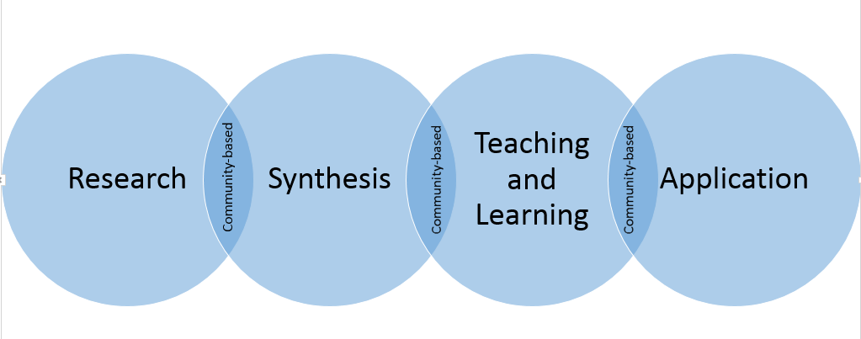

Slide 5
More in the great response to Boyer’s scholarship of application
National Review Board
Jeffrey Howard
A broadening of Glassick’s six categories of CES
Inclusion of community input throughout scholarly process to include public audiences for dissemination and public channels of critique
Thinking beyond the discipline/campus walls
NRB offered formal review at invitation of provost
Considers three steps in all scholarship (purpose, process and product)
Runs three Ps through a series of filters (community involvement, community benefit, scholarly involvement, scholarly benefit)
Reads like a useful checklist in CES

Slide 6
Which paradigm of scholarship best explains how you understand your CES?
Glassick, National Review Board, Howard
Notes:
Think, pair, share. It is my hope that identifying a paradigm of scholarship can help you plan a process for documenting your CES BEFORE your start your next project. I have created a worksheet for you to fill in. You can describe your community-based work, then in your own words, define how it is scholarly, then compare it to a given paradigm, whether Glassick, the NRB or Howard. This broad view will inform the argument you make in your portfolio about how your work is scholarship.
Take a few minutes now to write your first impressions. But expect to come back to this in the future.

Slide 7
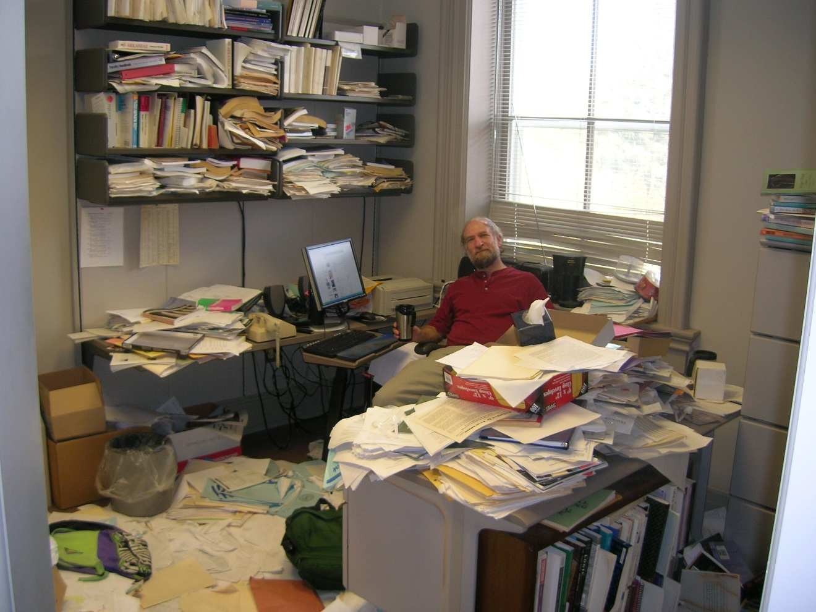
Ross’s recommendations
Develop a system of reflective notetaking
Document, document, document
Choose a measurement of success that CPs and scholars will appreciate
Notes:
Once you have done the big picture work, remember a few recommendations: (1) Develop a system of reflective notetaking so that you can answer the questions in a given paradigm explaining at each step how what you are doing is scholarly. Set aside a time regularly (monthly, end of semester) to ensure your work continues to meet the criteria of scholarship in the paradigm you choose. This keeps you honest. (2) Document community meetings and partner input. Every meeting, every email of input could be useful in your portfolio in making the case for CP involvement and benefit. So create a system to manage it. (3) Develop a system for measuring your success toward your goals that will speak to your CPs and planned audience. You have to make a compelling case for the value of your work to your community and to your field of knowledge. If your partners can’t understand it, then you’ve failed. If your peers in your field can’t see the value, then you have failed. So be clear about what success will look like and how it will be measured.

Slide 8
How might I publish?

Slide 9
Collaboration with different ends
Scholarship, research, creative activity
Democratic values and civic responsibility
Higher Ed knowledge & resources + Public/Private Sector knowledge & resources
Curriculum, teaching, learning
Critical social issues
Educated, engaged citizens
Common good
Notes:
Remember that we all have disciplines from which we emerge but we have very different goals about how we use our disciplinary expertise. As a result, these goals may effect the type of project we undertake, the partner we work with, or the product that results. The traditional categories of publication may no longer apply. Or if they do, the traditional fields in which you publish may not longer be a fit, meaning you might have to look beyond your discipline.
An example might be a teacher educator. You may find that your partnership in the middle focuses on curriculum and teaching, but the product resulting might not be your standard consultancy or article. You may design and implement a professional development school IN A SCHOOL. Suddenly that puts you in a whole new area of relevance, publishing and speaking about the common good of education. Or another example: you may be publishing your research about achievement gaps locally delineated by your geography, SES, ethnicity or systemic oppression, but you are also getting your teacher candidates interested in the topic in your classes. The ability of your teacher candidates to move beyond awareness to action on these social issues creates “educated, engaged citizens” way over on the other side of this slide. And you could find yourself next to faculty in political science, sociology or history, having something in common. So be prepared to work and think across disciplines you might not normally have considered, and think about opportunities for dissemination of your work more broadly.

Slide 10
Areas of CES publication
Perspectives of Jeffrey Howard, editor at the Michigan Journal for Community Service Learning
Categories of publication are not discrete and can overlap
Scholarship on CE teaching and learning
  Writing related to teaching a S-L course
Research on service-learning
  Studies of impacts of S-L
Scholarship of engagement
  Writing on your involvement in community, benefit to community, your involvement of expertise and scholarly results (with or without students)
Scholarship on engagement

Slide 11
Publication on Community Engaged Teaching and Learning
Critical Community Service-Learning: Combining Critical Classroom Pedagogy with Activist Community Placements
Points of Discomfort: Reflections on Power and Partnerships in International Service Learning
Student Perceptions of Community-Based Research Partners and the Politics of Knowledge
Notes:
A case study focused on outcomes
A new model of service-learning within a discipline
An interdisciplinary model
A comparison of outcomes of different models
An innovation in reflection techniques
A self-journey (lessons learned)

Slide 12
Research on S-L itself
College Students’ Negotiation of Privilege in a Community-Based Violence Prevention Program
Negotiating Border Crossing: Influence of Social Identity on Service-Learning Outcomes
The Relationship of Service-Learning and Degree Completion
From Serendipity to Resolve: Graduate Student Motivation to Teach using Service-Learning
Notes:
Research on service-learning: a scholarship that examines impacts of S-L on different constituents
Students (academic, civic, motivational, retention, ethical development)
Faculty (motivations, perceived benefits, perceived impediments, faculty development, roles & rewards)
Communities (impacts and partnerships)
Disciplines (varying conceptualizations of community; scholarly benefit)
Institutions (partnerships, institutionalization, strategy, impediments, mission fit)

Slide 13
Scholarship of engagement
Principles for Best Practice in Community-Based Research
A Case-Study of a Community Based Participatory Evaluation Research Project
Notes:
Writing on your involvement in community, benefit to community, your involvement of expertise and scholarly results (with or without students)
Could be Community-based research or public scholarship
CBR-research project, co-developed by faculty and community partner, that benefits (a) community and (b) faculty member’s scholarship
Public Scholarship-contributes to public good and yields a product that has public and/or intellectual value (e.g. Imagining America project)

Slide 14
Scholarship ON engagement
Place-Building Theory: A Framework for Assessing, Advancing and Critically Examining Community Engagement in Higher Ed
The Role of Incentives in Attracting Faculty to Engaged Scholarship
What Influences Long-Term Service-Learning Sustainability: Lessons from Early Adopters
University Leaders Use of Episodic Power to Support Faculty Community Engagement
Notes:
the investigation of some facet of higher-ed and community partnership

Slide 15
Where do you see a fit with your CES when it comes time to publish?
Notes:
Think, pair, share.

Slide 16
Some more recommendations for BEFORE you publish
Do
Don’t
Articulate your research question; get feedback from colleagues &CPs
Align research question, the literature review and methodology (good fit?)
Address CES criteria in your research and writing (check with journal)
Collect good data using rigorous methods, with CP input
Choose co-authors (include community)
Follow journal’s specified guidelines
Adopt a weak research method
Ignore extant literature (think across disciplines, too)
Forget a lay readership especially if including a CP as co-author
Format article weakly (let goals of article inform lit review, method, results and discussion)

Slide 17
More recommendations, this time AS you publish
Do
Don’t
Review recent issues of journals to find a good fit
Follow alignment of an exemplary article (goals inform all content)
Contact editorial board (if allowed) to discuss fit
When asked to “revise and resubmit,” use a cover letter listing all changes made
Conform to journal’s chosen style
Conform content too much (editors want groundbreaking material)
Submit a hot mess
Offer an article that doesn’t fit journal goals
Overlook criteria of scholarship (be literal if need be)
Ignore style guidelines
Write more description than analysis

Slide 18

Where can you publish?
See handout for list of publication outlets.
Visit the excellent site at Fairfield University
http://librarybestbets.fairfield.edu/content.php?pid=565374&sid=4659491
Sign up for Washington Campus Compact’s Pen to Paper writing retreat on CES in 2018.

