Slide 1
Community Engaged Scholarship
The Basics
Patricia Lucero Chantrill, Professor of Communitcation, Eastern Washington University
Ross Brooke Watts, Director of the Dornsife Center for Community Engagement, Whitworth University

Slide 2
Session goals
To place CES in the context of a larger body of literature examining how universities and communities interact
To review some of the better known definitions of CES
To appreciate the terminological messiness of CES
To apply the terms of CES to your own work in the community
To identify elements of CES (and obstacles to them) in faculty stories

Slide 3
CES as a field of inquiry
Lorilee Sandmann and “Punctuated Equilibrium”

Slide 4
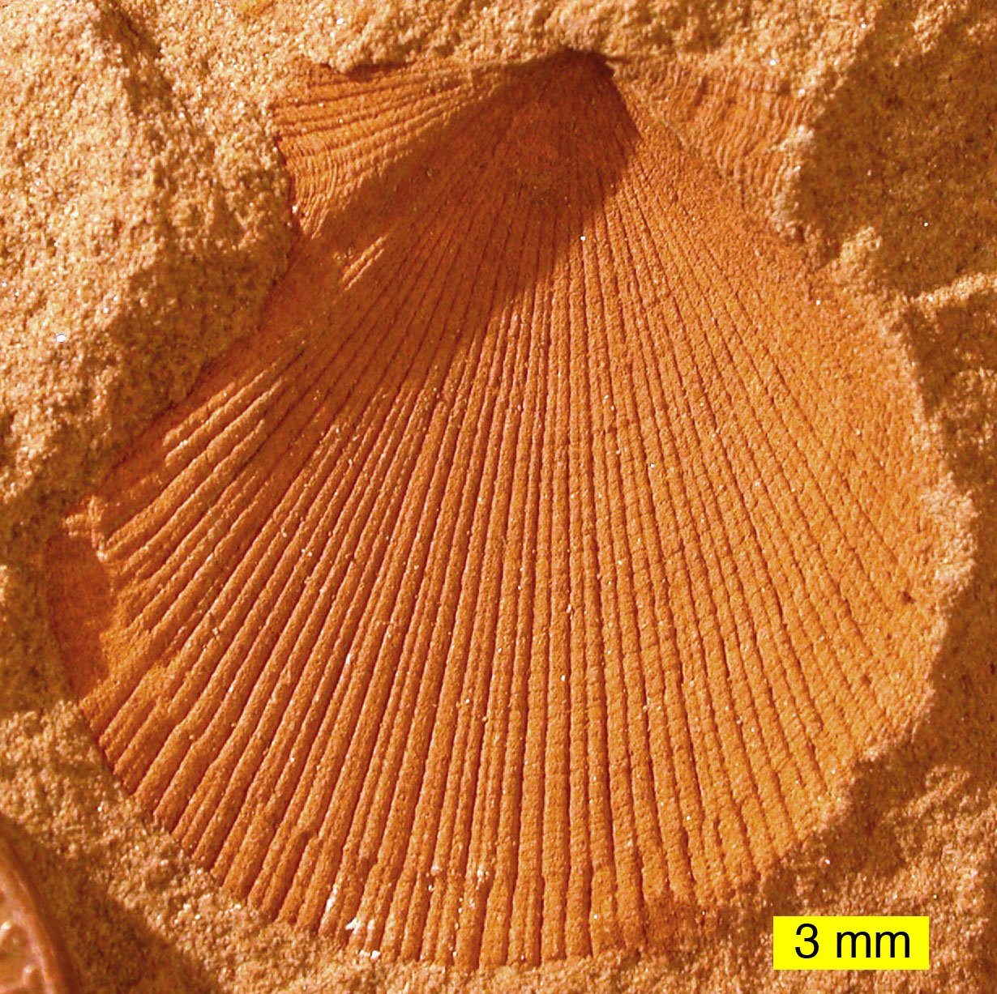
What does evolutionary biology have to do with my academic work in the community?
Eldredge and Gould (1972) explained the radical transformations in speciation following long periods of continuity
Sandmann (2008) applies term to scholarly writing on engagement

Slide 5
Punctuations in writing on engagement
2. Deploying engagement (2000s)
1. Defining engagement (1990s)
Follow up to Boyer (1990)
Effort to differentiate engagement from outreach or public service
Bidirectional interaction
Integration of teaching and research with a public mission
Applying engagement through instruction and/or research
Descriptive works such as case studies and benefits analyses
Reciprocity present
Knowledge generation is public participation lacking

Slide 6
Punctuations, continued
3. Engagement as scholarship (2000s – present)
4. Engagement institutionalized (2000 – present)
Writing on engagement work as scholarship related to institutional context
  Integration, research and application
Writing that articulates qualitative features of scholarship that apply to engagement work
  Improving quality of scholarship
Writing that examine institutional barriers to a new scholarship
Notes:
Patty to add her story of colleague encounter (National Communication Association). Main point: in a period of punctuated equilibrium, scholars of the same generation may perceive that change is coming too quickly AND too slowly.
“So, although there are multifaceted practices, engaged scholarship (as engagement as scholarship has come to be called) has evolved as a distinct dimension of the engagement movement and is evolving a distinctive scholarly expression and architecture. It builds on, and yet differs from, traditional scholarship, which is perceived to be disciplinary, homogenous, expert-led, supply driven, hierarchical, peer-reviewed and almost exclusively university-based knowledge generation. Engaged knowledge generation, in contrast, is applied, problem-centered, demand driven, entrepreneurial, network-embedded, and so on.” (Sandmann, 2008)

Slide 7
Definitions of CES

Slide 8
Useful articulations from the ‘90s and ‘00s
Ernest Lynton, 1995
  AAHE publication
National Review Board for the Scholarship of Engagement, 2005
Jeffrey Howard, 2007
  Campus Compact publication

Slide 9
Lynton, 1995
Making the Case for Professional Service
Effort to distinguish CES from
  Institutional citizenship (committee work, etc.)
  Disciplinary citizenship (peer-review, journal work, etc.)
  Civic contributions (public office, philanthropy, volunteering)
“Insistence on professional expertise [in course of engagement] sufficiently distinguishes” CES (p. 18)

Slide 10
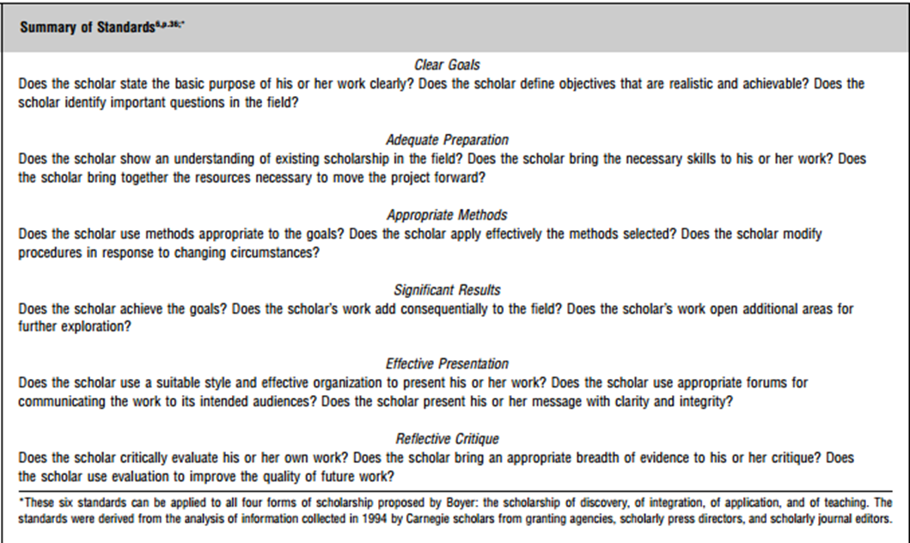
Lynton’s Features of CES
1. The scholar learns something (discovery/originality/absence of SOP)
2. Knowledge advances base of discipline
3. Scholarly activity is responsive and adaptive
4. Reasoned choice of goals reflecting agreement with client
5. Methods chosen appropriate to scope of work and context

Slide 11
More Lynton (1995)
6. Scholar undertakes reflection (observing, assessing, making adjustments)
7. Reflection generates outcomes (results, inferences, new insights that can be generalized)
8. Outcomes can be shared with colleagues formally or informally (community)
Notes:
Glassick, 1997, for the Carnegie Foundation in the Scholarship of Teaching
6 standards of scholarly work
1. Does scholar have clear goals?
2. Is scholar adequately prepared for the project? (Lit review, expertise, resources)
3. Has the scholar chosen appropriate methods? (adaptive to changes?)
4. Does the scholar achieve goals? (significant?)
5. Is there effective presentation of work?
6. Is there reflective critique? (self-evaluation, breadth of evidence?)

Slide 12
National Review Board on Sch. of Engagement
Goals/Questions
Does the scholar state the basic purpose of the work and its value for public good?
Is there an "academic fit" with the scholar's role, departmental and university mission?
Does the scholar define objectives that are realistic and achievable?
Does the scholar identify intellectual and significant questions in the discipline and in the community?
Context of theory, literature, "best practices"
Does the scholar show an understanding of relevant existing scholarship?
Does the scholar bring the necessary skills to the collaboration?
Does the scholar make significant contributions to the work?
Is the work intellectually compelling?
Methods
Does the scholar use methods appropriate to the goals, questions and context of the work?
Does the scholar describe rationale for election of methods in relation to context and issue?
Does the scholar apply effectively the methods selected?
Does the scholar modify procedures in response to changing circumstances?

Slide 13
More National Review Board
Results
Does the scholar achieve the goals?
Does the scholar's work add consequentially to the discipline and to the community?
Does the scholar's work open additional areas for further exploration and collaboration?
Does the scholar's work achieve impact or change? Are those outcomes evaluated and by whom?
Does the scholar's work make a contribution consistent with the purpose and target of the work over a period of time?
Communication/Dissemination
Does the scholar use a suitable styles and effective organization to present the work?
Does the scholar communicate/disseminate to appropriate academic and public audiences consistent with the mission of the institution?
Does the scholar use appropriate forums for communicating work to the intended audience?
Does the scholar present information with clarity and integrity?
Reflective Critique
Does the scholar critically evaluate the work?
What are the sources of evidence informing the critique?
Does the scholar bring an appropriate breadth of evidence to the critique?
In what way has the community perspective informed the critique?
Does the scholar use evaluation to learn from the work and to direct future work?
Is the scholar involved in a local, state and national dialogue related to the work?

Slide 14
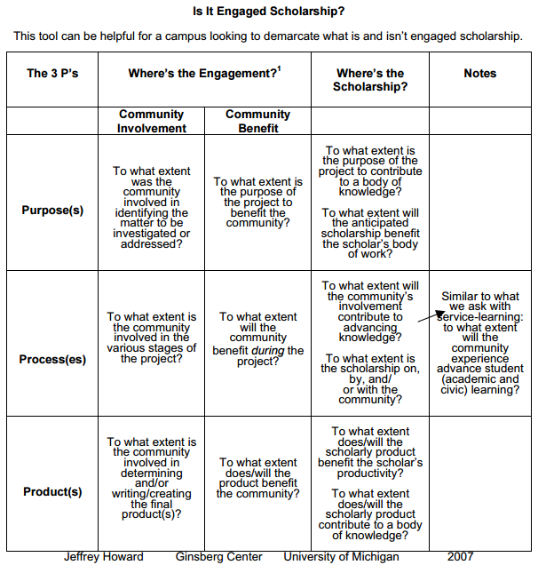
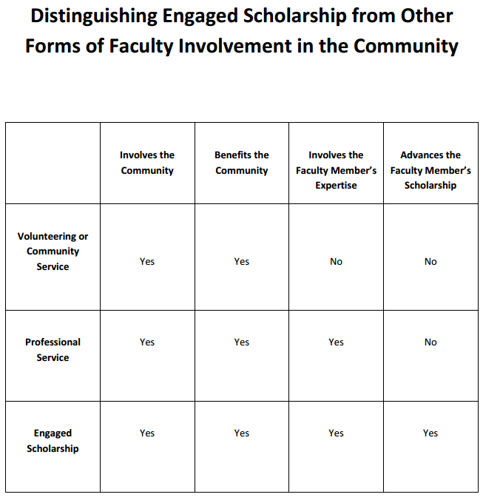
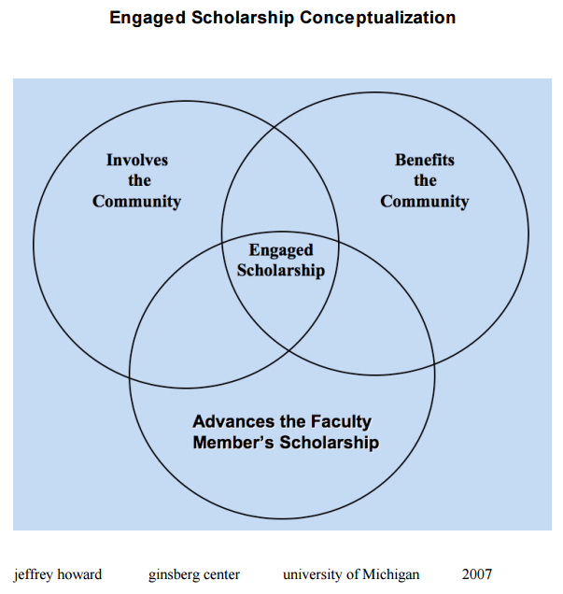
Howard, 2007
An effort to simply the explanation of CES
An effort to distinguish CES from other types of service
What purposes, products and processes serve as evidence of scholarship?

Slide 15
Patricia Lucero Chantrill
Applying the criteria of Lynton, the National Review Board and Howard to public scholarship.

Slide 16
An exercise
Apply the criteria of Lynton, the National Review Board or Howard to your own work in the community

