Slide 1
Critical Reflection
Meaning Making in Service-Learning

Slide 2
Service-learning is a credit-bearing educational experience in which students participate in an organized service activity that meets identified community needs, and reflect on the service activity in such a way as to gain further understanding of course content, a broader appreciation of the discipline, and an enhanced sense of civic responsibility.
Bringle & Hatcher, 1996, p. 222

Slide 3
“We don’t learn from experience. We learn from reflecting on experience.”
-John Dewey (Dewey, 1938 p. 13)
Notes:
Through reflection students analyze concepts, evaluate experiences, and form opinions. Critical reflection provides students with the opportunity to examine and question their beliefs, opinions, and values. It involves observation, asking questions, and putting facts, ideas, and experiences together to derive new meaning and new knowledge.
Reflection is a process designed to promote the examination and interpretation of experience and the promotion of cognitive learning.

Slide 4
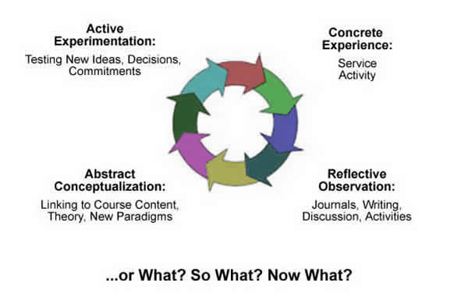
Kolb Learning Cycle
Integration of Experience w/Curricular Knowledge
http://teaching.colostate.edu/guides/servicelearning/principles_whatis_kolb.cfm
Notes:
Learning is a process rather than an outcome. Learning is the process by whereby knowledge is created through the transformation of experience.
Reflection improves basic academic skills and promotes a deeper understanding of course subject matter and its relations to the non-academic world; it improves higher level thinking and problem solving, and students’ ability to learn from experience. Reflection promotes personal development by enhancing students’ self-awareness, their sense of community, and their sense of their own capacities.

Slide 5
Reflection’s 4Cs
Continuous
Connected
Challenging
Contextualized
It should:
      Provide students a variety of opportunities to reflect on thoughts, feelings, and curricular connections before, during and after the project.
      Examine the results, processes and relationships encountered in through the project
      Help students consider the social and ethical dimensions of their project
      Create clear connections between the service experience and academic curriculum
      “To reflect in service-learning is to give careful consideration to the relationship between service, curriculum, self and community.” -Making Time for Reflection
Notes:
4 Cs – Continuous, C

Slide 6
Reflection Models & Tools

Slide 7
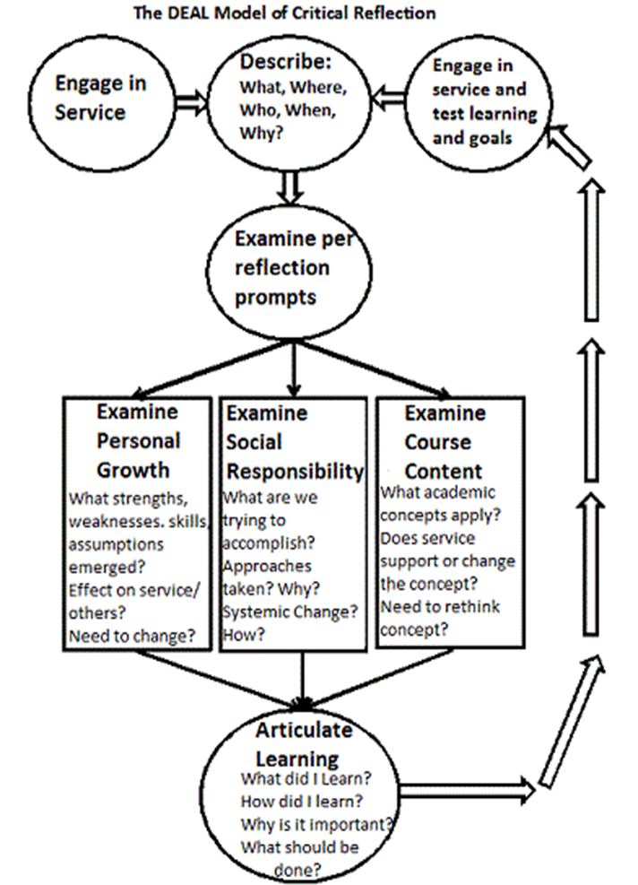
DEAL
Model
Describe
Examine &
Articulate
Learning
Notes:
Each time students reflect on the experience they should go through the sequence of the DEAL

Slide 8
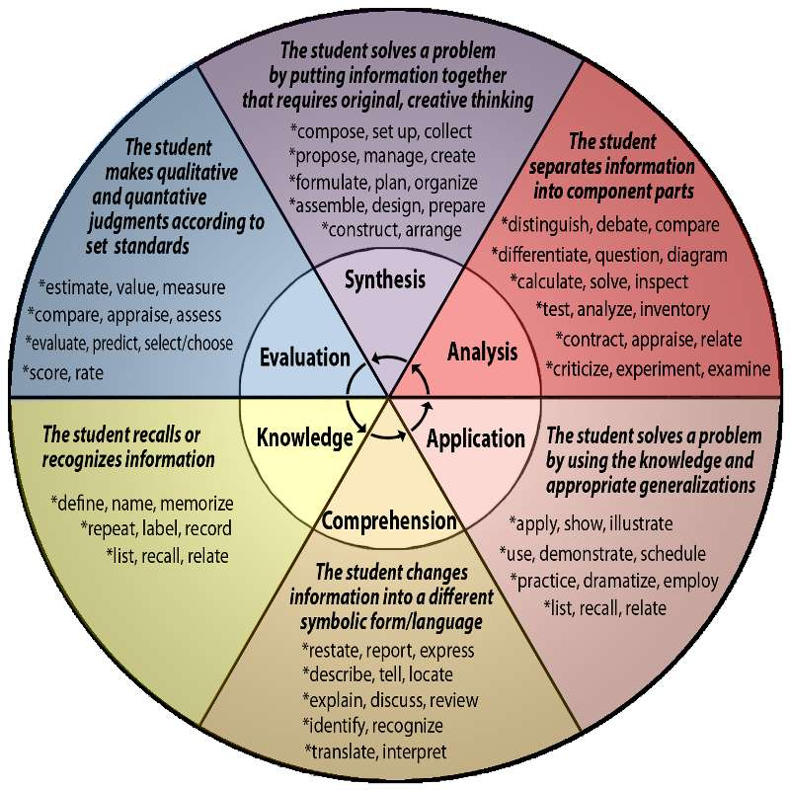
Bloom’s Taxonomy
Notes:
In order to think critically and grow through the service learning experience, we employ all
levels of this taxonomy or categories of intellectual behavior. Verbs utilized in reflection prompts will indicate
which level is used. (Knowledge, Comprehension, Classify, Application, Analysis, Synthesis, Evaluation).

Slide 9
Bloom’s Six Domains
Knowledge
Identify a theory/concept that relates to your service experience.
Comprehension
Explain how the previous reading relates to what you are experiencing at your service site.
Application
How did you see a theory/concept in action in your service experience?
Analysis
What are some possible reasons for the differences between the course material and your service experience?
Synthesis
What resources and strategies would you use to evaluate the effectiveness of this service project in meeting the needs of your community partner?
Evaluation
What are the strengths and weaknesses of this theory/model/concept in the context of your service experience?
Adapted from Boise State’s Reflection: Theory & Practice Training references Krawthwohl, D.R. (November 01, 2002). A Revision of Bloom’s Taxonomy: An Overview. Theory into Practice, 41 (4), 212-218.

Slide 10
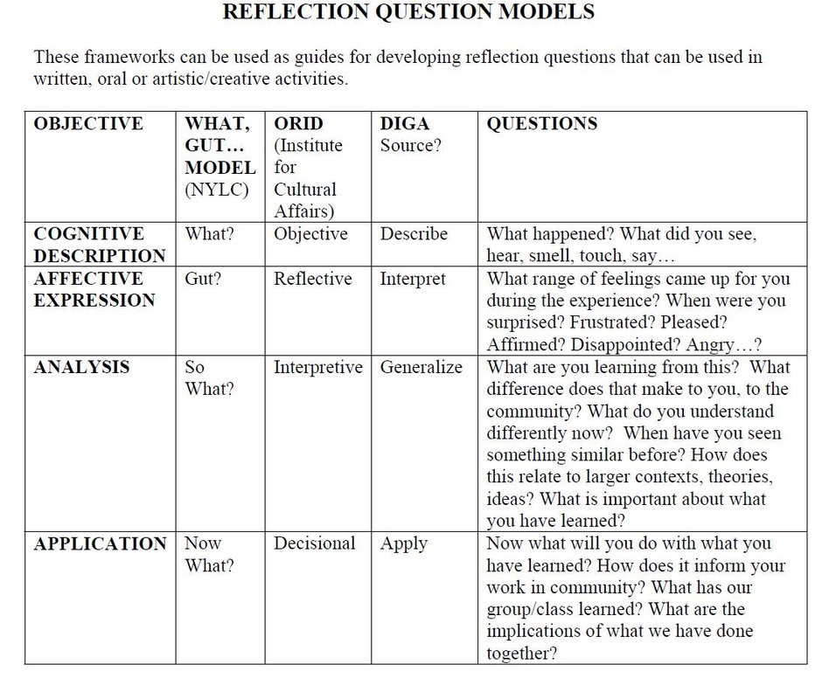
As found at http://www.jsheblakfamily.com/reflection-question-models.html

Slide 11
Reflection Techniques
Journals/Discussion Boards
Group Discussions
Papers
Presentations
Community Partner/Leader Interview
Portfolios
Blogs

Slide 12
Planning Reflections
Use a map to visualize potential reflection activities throughout the service:
 | Before | During | After
Alone | Letter to Self | Structured Journal | Reflective Essay
With Classmates | Hopes/Fears Discussion | Group Discussion | Team Presentation
With Community Partners | Asset Mapping | Debriefing | Presentation to Community Group
Reflection Maps
Or to visualize reflection activities for different learning styles:
 | Before | During | After
Reading | “Role of Service” Articles | Case Studies | Point/Counterpoint articles
Writing | Letter to self | Critical questions essays | Integrative papers
Doing | Field data gathering | Oral histories | Artistic reflection
Telling | Informal discussions | Oral presentations | Reflection with community
Adapted from Boise State’s Reflection: Theory & Practice Training http://servicelearning.boisestate.edu/faculty/files/2011/10/Reflection101Outline.pdf

Slide 13
Assessing/Evaluating Reflection
 | Identify | Apply | Analyze | Evaluate
Exemplary | Reflection demonstrated student’s knowledge by identifying and describing academic concepts that are connected to service-learning experience. For example: “This experience reminded me of our discussion about…” | Reflection demonstrated student’s ability to apply academic concepts in the context of his/her service experience. For example: “This is how I see this theory/concept/model in action in my service-learning experience…”. | Reflection demonstrated student’s ability to analyze the relationship between the academic material and his/her service experience. For example: It seems that the difference between this theory/concept/model and my experience are due to…” | Reflection demonstrated student’s ability to evaluate the relevance of the course material in the context of their service. For example: “The strengths/weakness of this theory in my service experience was. . .Given this evaluation, I would recommend.”
Adapted from Boise State’s Reflection: Theory & Practice Training http://servicelearning.boisestate.edu/faculty/files/2011/10/Reflection101Outline.pdf

Slide 14
Reflection Tools
Civic Engagement VALUE Rubric AAC&U
Center for Civic Reflection
Student Reflection Blog Rubric
Office of Community Engagement Wiki

